Slide 1

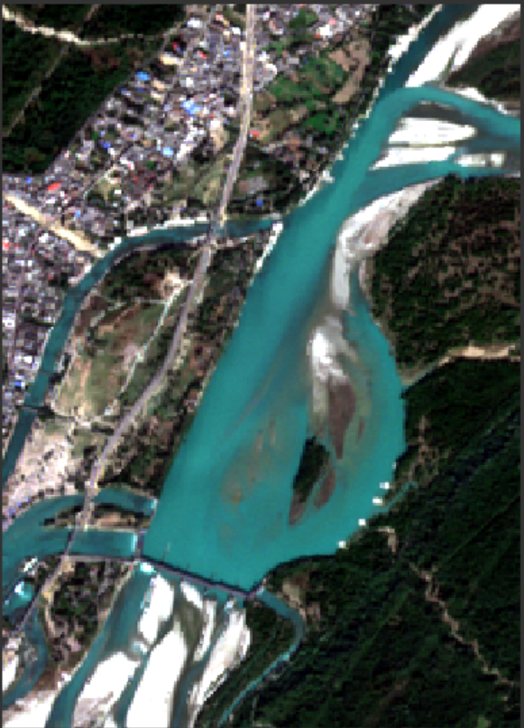
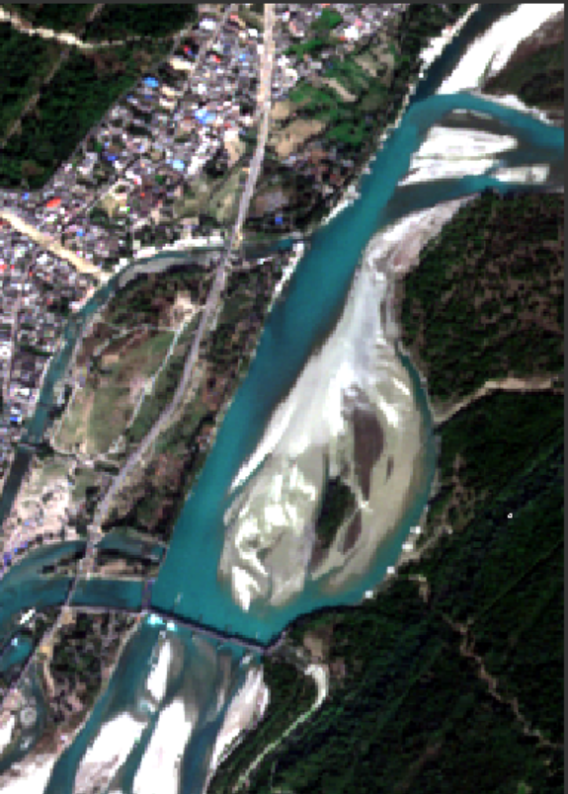
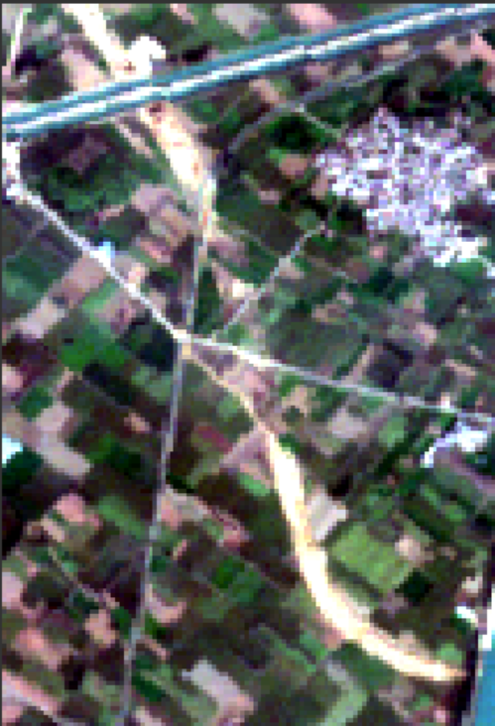
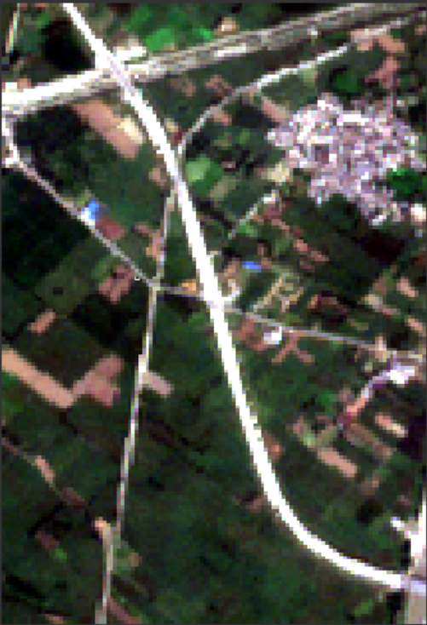


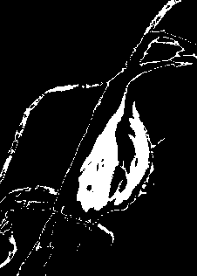
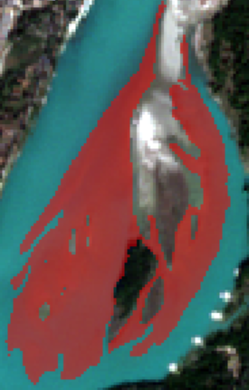


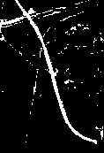

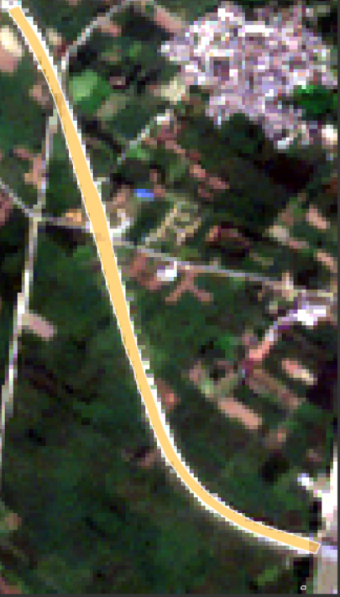











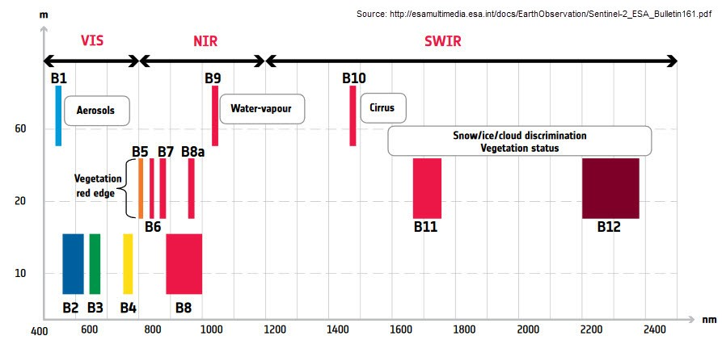
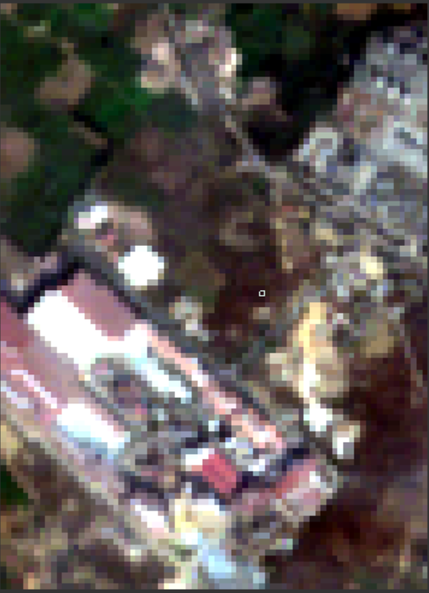
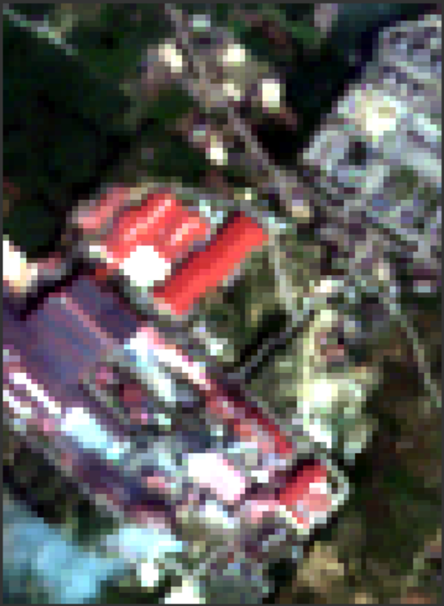
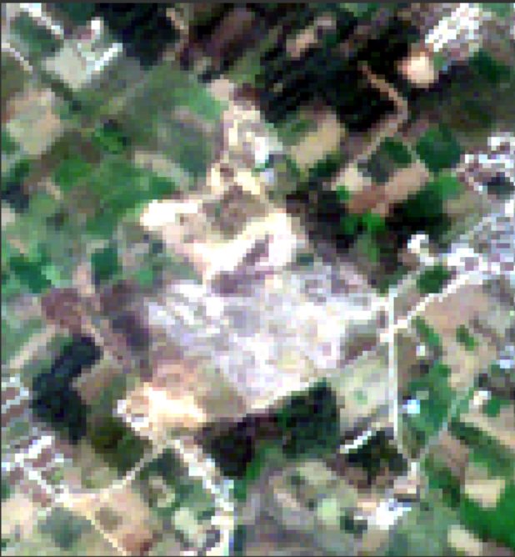
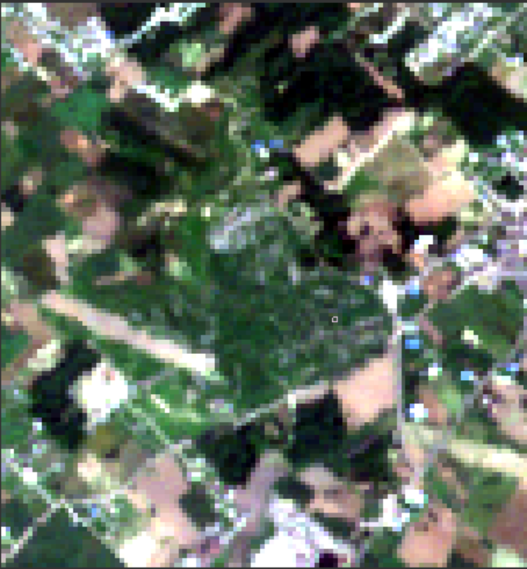



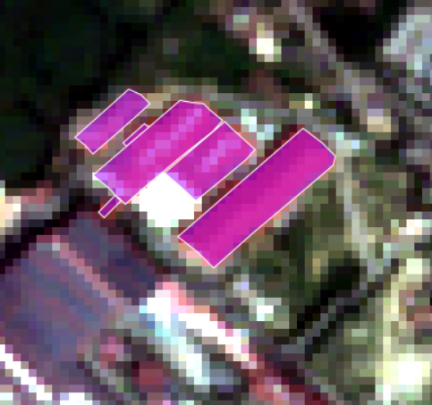

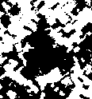
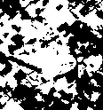
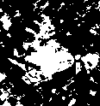
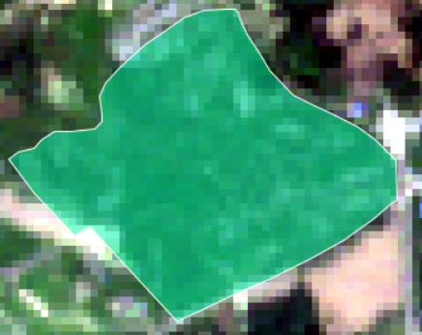




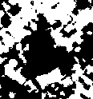
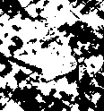
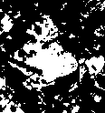



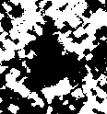

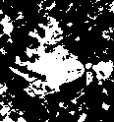
AI/ML in target detection for reduction in False Alarm
Divyansh Verma, Krishna Bhardwaj
(divyansh_bv@ece.iitr.ac.in, krishna_b@ece.iitr.ac.in )
Supervised by – Dr. Dharmendra Singh and Lieutenant Colonel Him Dhawan
Department of Electronics and Communication Engineering, Indian Institute of Technology, Roorkee
Objectives
Results
To find the efficient ML technique for detection of different classes in target area like Vegetation, Water Body, Building and Road
To detect the change of different classes in two images of different dates using different ML techniques like Support Vector Machine, Random Forest and Deep Neural Networks
To reduce the false alarms in the results and hence improve the accuracy.
WATER
CLASS
ROAD
CLASS
Introduction
Sentinel-2 images of two different dates as input data
Sentinel-2 images of two different dates as input data
Change detection (CD) is a phenomenon of detecting change in targets of the same geographical area by observing the set of images captured at different periods to find Geospatial changes : natural or human-made occurrences. Remote Sensing (RS) technology provide a potent data source for continuous observation and evaluation over time for evaluating changes various temporal and spatial resolution datasets. To learn the reduction of false alarms, this project implements Post-classification techniques of change detection: Random forest, Support Vector Machine and Neural Network.
This study involves satellite imageries of Sentinel-2 satellite. To extract features for implementing classification techniques, spectral indices of respective classes are used. Three classification techniques are utilized to deduce an optimum classification model. After the classification maps are produced, change in the target area is evaluated from the results of two dates. Reference image from google earth is compared with results to calculate confusion matrix. False alarms are then reduced by refining the model which further improves the accuracy of change detection model.
Various classification techniques used here are Support Vector Machine(SVM), Random Forest and Deep Neural Network(DNN). SVM classify data points even when they are not otherwise linearly separable by mapping the data to a high-dimensional feature space. Random forest combines the output of multiple decision trees to reach a single result. DNN represents the type of machine learning when the system uses many layers of nodes to derive high-level functions from input information.
Application :
Tracking environmental conditions – deforestation, desertification
Land-use and land-cover (LULC) change
Impact of natural disasters - floods
Urban expansion
Agriculture : finding changes in vegetation
Analyzing climate change
16-11-2019
06-12-2019
31-12-2018
21-10-2022
Classification results for image dated
Change Detection
Ground Truth or Reference image for the change
Classification results for image dated
Change Detection
Ground Truth or Reference image for the change
16-11-2019
06-12-2019
31-12-2018
21-10-2022
SVM RESULTS
SVM RESULTS
Confusion Matrices | [11684 435 ] [ 14 425 ]
[11989 130] [ 42 397] | [12013 106 ] [ 44 395 ]
Confusion Matrices | [9384 1097] [ 221 4098]
[9574 907 ] [ 267 4052] | [9400 1081] [ 228 4091]
SVM
SVM
RANDOM FOREST RESULTS
R.FOREST
DNN
RANDOM FOREST RESULTS
R.FOREST
DNN
Dataset
DNN RESULTS
Area inside red rectangle is area of interest on which accuracy of different ML techniques are being tested
DNN RESULTS
Area inside red rectangle is area of interest on which accuracy of different ML techniques are being tested
DATASET :
Area : Uttarakhand – Saharanpur, Roorkee, Haridwar region
Data : Sentinel-2
Sentinel-2 Characteristics :
  Sensor: Multi-spectral data with 12 bands in the visible, near infrared, and short wave infrared part of the spectrum
  Global Coverage: 56° S to 84° N
  Spatial resolution of 10 m, 20 m and 60 m
  Orbit : Twin polar-orbiting satellites in the same orbit, phased at 180° to each other
  Data availability : Free and open data policy
BUILDING
CLASS
VEG
CLASS
Fig-1. Sentinel-2 bands spectrum
Sentinel-2 images of two different dates as input data
Sentinel-2 images of two different dates as input data
Methodology
Classification results for image dated
31-12-2018
21-10-2022
Classification results for image dated
31-12-2018
21-10-2022
WORK FLOW:
As shown in the figure 1 different band images are obtained using different wavelength waves, Hence different bands contains information about different land covers in a different way. For example band-2 and band-3 image will have different pixel value at the same location.
New bands can also be formed using available bands. Mathematical operation can be applied on the values in the 2 bands to get a new band. These new bands are also known as spectral indices.
These spectral indices are very helpful in highlighting some of the features like PISI spectral indices can highlight the road, NDWI can highlight the water surface present in the image.
Hence we have added 4 new spectral indices namely PISI, NDBI, NDVI, NDWI to out data. The description of different spectral indices can be found in the table 1.
Hence for one pixel of an image we have 16 band data and we need to form corresponding output to train out ML technique model.
31-12-2018
21-10-2022
Change Detection
Ground Truth or Reference image for the change
31-12-2018
21-10-2022
Change Detection
Ground Truth or Reference image for the change
SVM RESULTS
Confusion Matrices | [2373 182 ] [ 82 168 ]
[2471 84 ] [ 92 158] | [2451 104 ] [ 89 161 ]
SVM RESULTS
Confusion Matrices | [1207 429 ] [ 69 1068]
[1207 429 ] [ 71 1066] | [1205 431 ] [ 74 1063]
For output preparation we have used masking technique in which a mask is created on some class and pixels values for that are picked up.
Basically we have picked up some pixels of each class using SNAP software.
Now to prepare for certain class say road we give output corresponding to road pixel as 1 and rest as 0. Similarly for the other classes.
After that model is trained for input and output and it is run on the whole image to detect certain class.
Spectral Indices | Spectral Indices Formula
NDWI | Normalized Difference Water Index(NDWI) NDWI = (GREEN-NIR) / (GREEN+NIR)
PISI | Perpendicular Impervious Surface Index (PISI) PISI = 0.8192 * BLUE - 0.5735 * NIR + 0.075
NDBI | Normalize Difference Build-up Index(NDBI) NDBI = (SWIR – NIR) / (SWIR + NIR)
NDVI | Normalized Difference Vegetation Index(NDVI) NDVI = (NIR-RED) / (NIR+ RED)
SVM
SVM
RANDOM FOREST RESULTS
R.FOREST
DNN
RANDOM FOREST RESULTS
R.FOREST
DNN
DNN RESULTS
Area inside red rectangle is area of interest on which accuracy of different ML techniques are being tested
DNN RESULTS
Area inside red rectangle is area of interest on which accuracy of different ML techniques are being tested
Table 1. Spectral Indices Formula
MODEL ARCHITECHTURE:
Sentinel 2
(Temporal Data, 10m, 13 bands)
Reprojection
Resampling
Subset
Calculate Spectral Indices
and merge in bands
Conclusions
Support Vector Machine
Random Forest
Deep Neural Network
There are numerous techniques for detecting changes; however, it is difficult for selecting an optimum and definite method. The temporal, spatial, spectral and radiometric resolutions of remotely sensed data have a significant impact on the success of a remote sensing change detection project.
Post-classification-based approach delivers considerable accuracy as compared to the algebraic approaches.
False Alarms are reduced by :
  Fusing additional band in input data from Spectral Indices for respective classes.
  Better selection of ROIs for multi class results.
For water class Random Forest performs the best, for road class DNN performs the best, for building class Random Forest performs the best and for vegetation class SVM performs the best in change detection.
Classification Map
Date-1
Classification Map
Date-1
Classification Map
Date-1
Classification Map
Date-1
Classification Map
Date-1
Classification Map
Date-1
Acknowledgement
Change Map
We express our sincere gratitude to Dr. Dharmendra Singh and Lieutenant Colonel Him Dhawan for providing guidance in domain of remote sensing, datasets, knowledge of ML techniques and the infrastructure for our project.
Change Map
Change Map
References
Compare with Reference Image
(Google Earth)
Afaq, Yasir & Manocha, Ankush. (2021). Analysis on change detection techniques for remote sensing applications: A review. Ecological Informatics. 63. 101310. 10.1016/j.ecoinf.2021.101310.
Asokan, A., Anitha, J. Change detection techniques for remote sensing applications: a survey. Earth Sci Inform 12, 143–160 (2019). https://doi.org/10.1007/s12145-019-00380-5
S. Minu, Amba Shetty, A Comparative Study of Image Change Detection Algorithms in MATLAB, Aquatic Procedia, Volume 4
You, Y.; Cao, J.; Zhou, W. A Survey of Change Detection Methods Based on Remote Sensing Images for Multi-Source and Multi-Objective Scenarios. Remote Sens. 2020, 12, 2460.
Confusion Matrix
Accuracy

